Slide 1
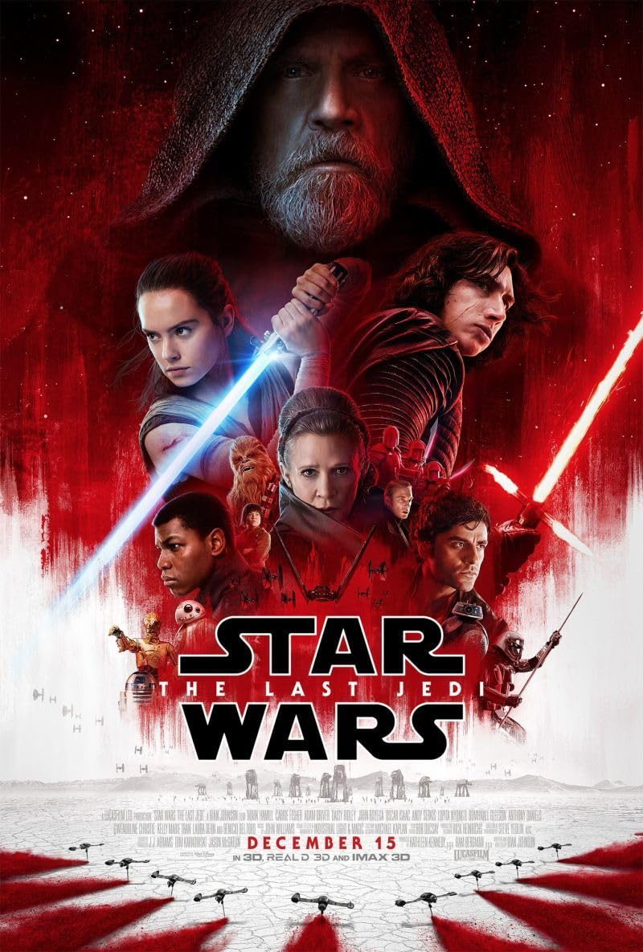

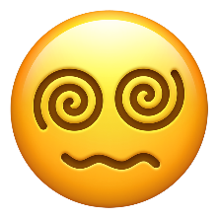








Star Wars: The Last Jedi
… also Star Wars: The Last Emoji
Reinis Bartkevičs 8.c

Slide 2
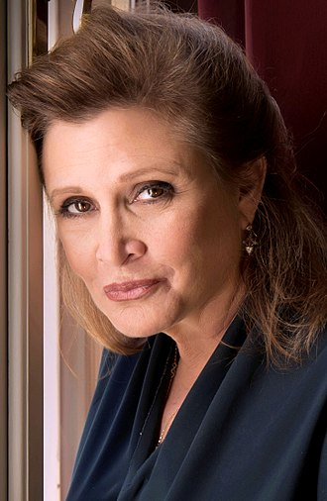
Description before the rule breaking
Release date: December 15, 2017
Starred: Carrie Fisher †, Mark Hamill, Adam Driver, Daisy Ridley, John Boyega, Oscar Isaac
The writer and director: Rian Johnson (originally Jeffrey Jacob Abrams)
Reception (Rotten Tomatoes):
Tomatometer: 93 % ( WOT!!! )
Audience Score: 56 %

Slide 3
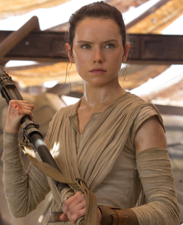
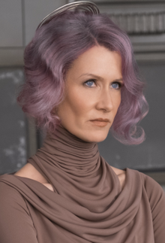
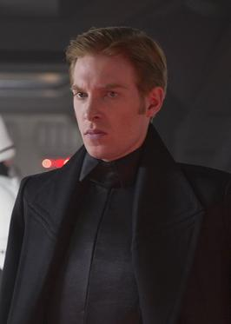
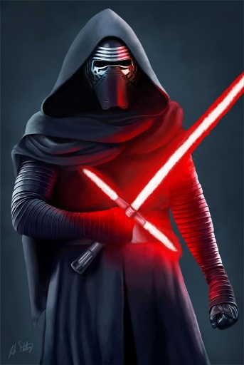
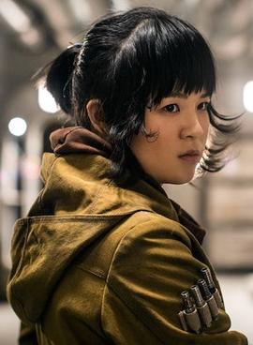
Characters
Rey
Poe Dameron
Holdo
Armitage Hux
Snoke
Kylo Ren
Rose Tico

Slide 4
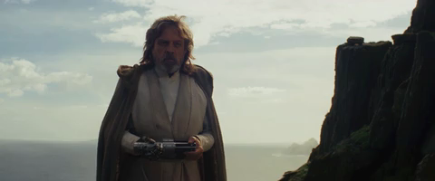
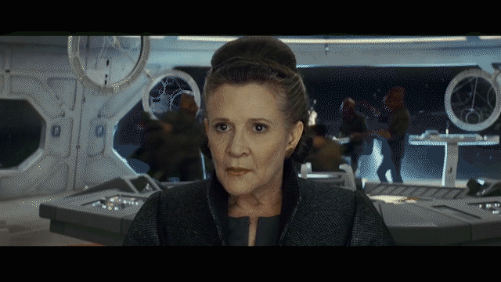
Plot
Rey develops her abilities with the help of Luke Skywalker, as the Resistance prepares for battle against the First Order.
Jedi Master-in-hiding Luke Skywalker unwillingly attempts to guide young hopeful Rey in the ways of the force, while Leia, former princess turned general, attempts to lead what is left of the Resistance away from the ruthless tyrannical grip of the First Order.
Following the battle of Starkiller Base, General Leia Organa leads Resistance forces to flee D'Qar when a First Order fleet arrives. Poe Dameron leads a costly counterattack that destroys a First Order dreadnought, but after the Resistance escapes to hyperspace, the First Order tracks them and attacks the Resistance convoy. Kylo Ren, Leia's son, hesitates to fire on the lead Resistance ship after sensing his mother's presence, but his wing-men destroy the bridge, killing most of the Resistance leadership and incapacitating Leia, who survives by using the Force. Disapproving of new leader Vice Admiral Holdo's passive strategy, Poe helps Finn, BB-8, and mechanic Rose Tico embark on a secret mission to disable the First Order's tracking device..

Slide 5
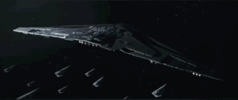
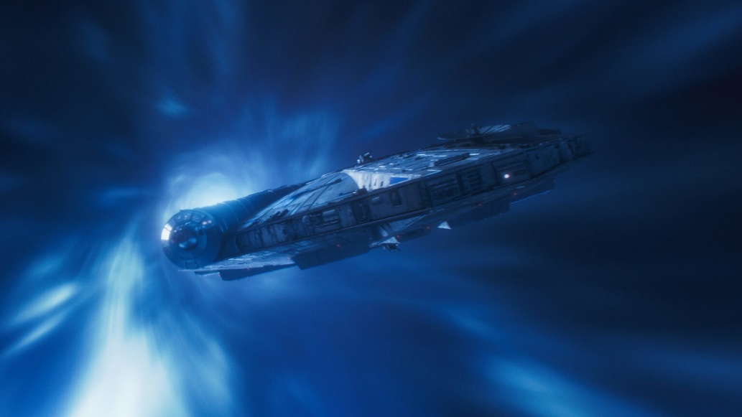
What is this?
The film features this scene where the Resistance flgship Raddus rammed the First Order flahship Supremacy. The ramming consisted of Holdo initiating her hyperspace jump and going at a near-lightspeed velocity. This doesn’t make sense with how hyperspace was treated before this film.

Slide 6
Thanks for your attention!!!

